Slide 1

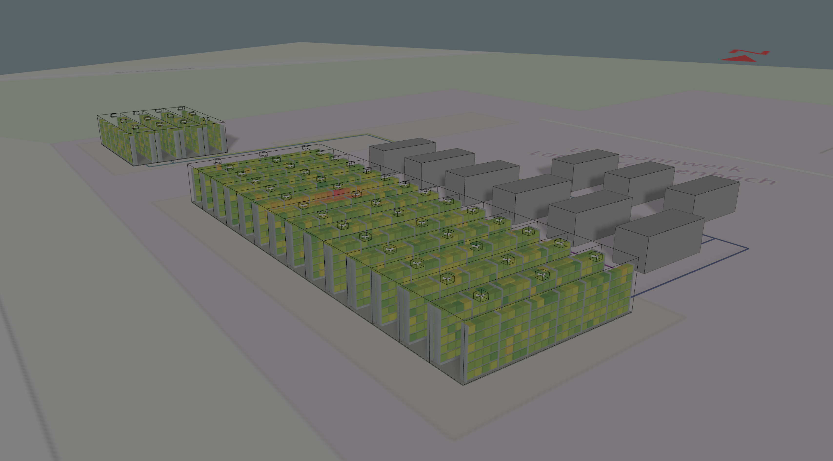
THE SMARTER E EUROPE 2025
3D Digital Twins
Making Complex Energy Systems Intuitive

Slide 2
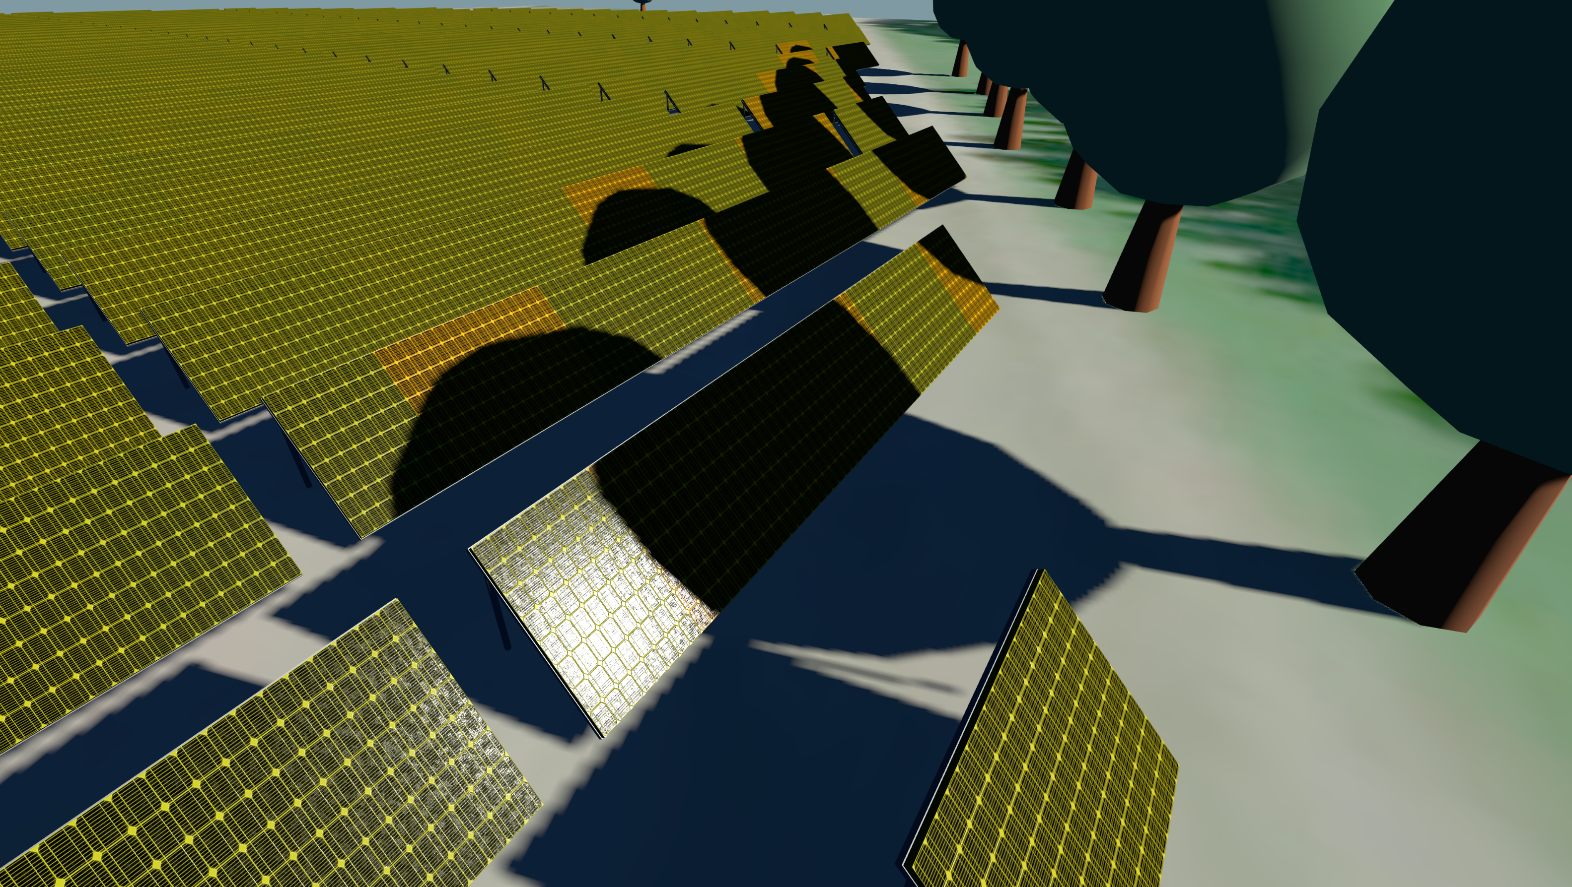
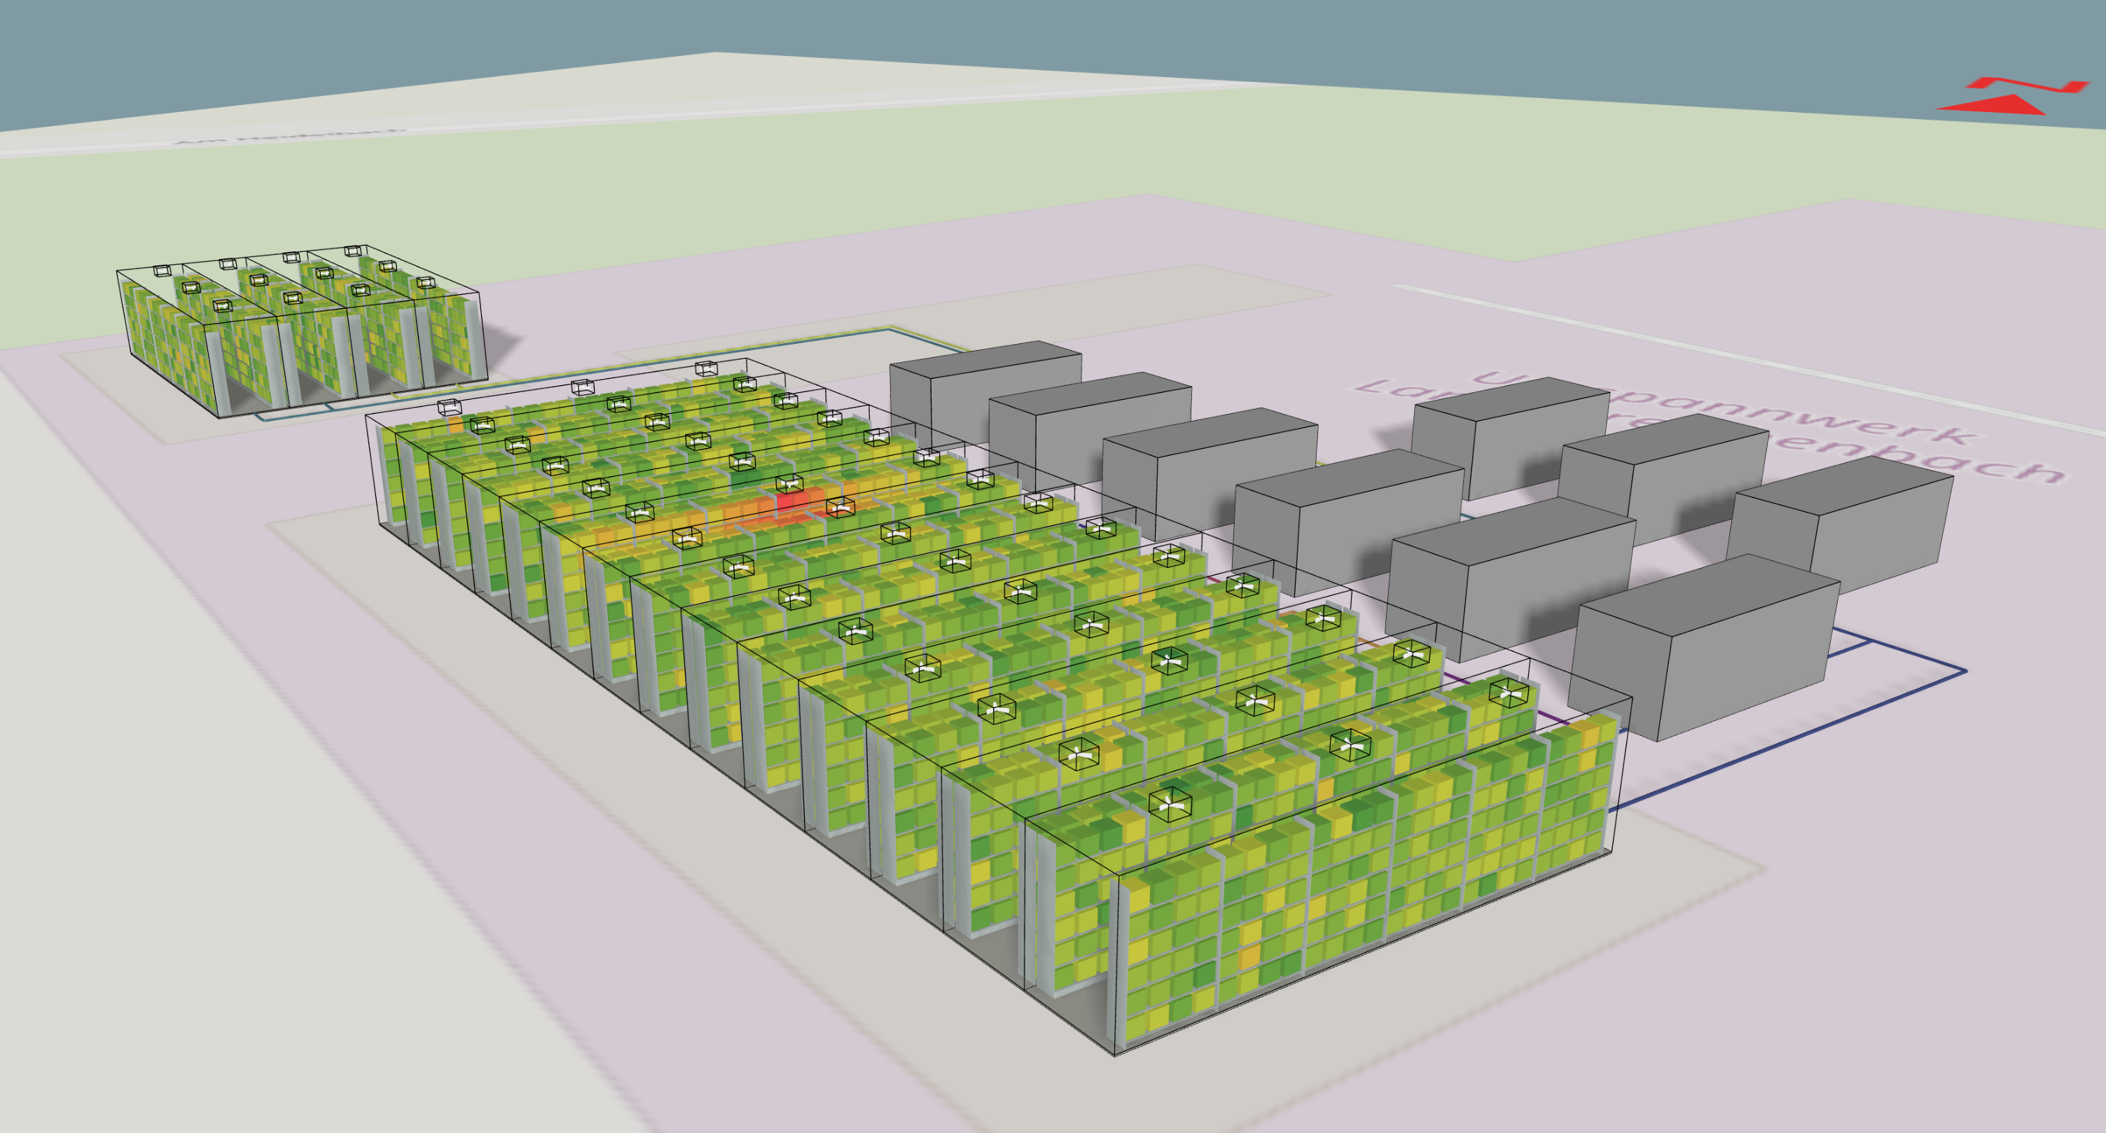
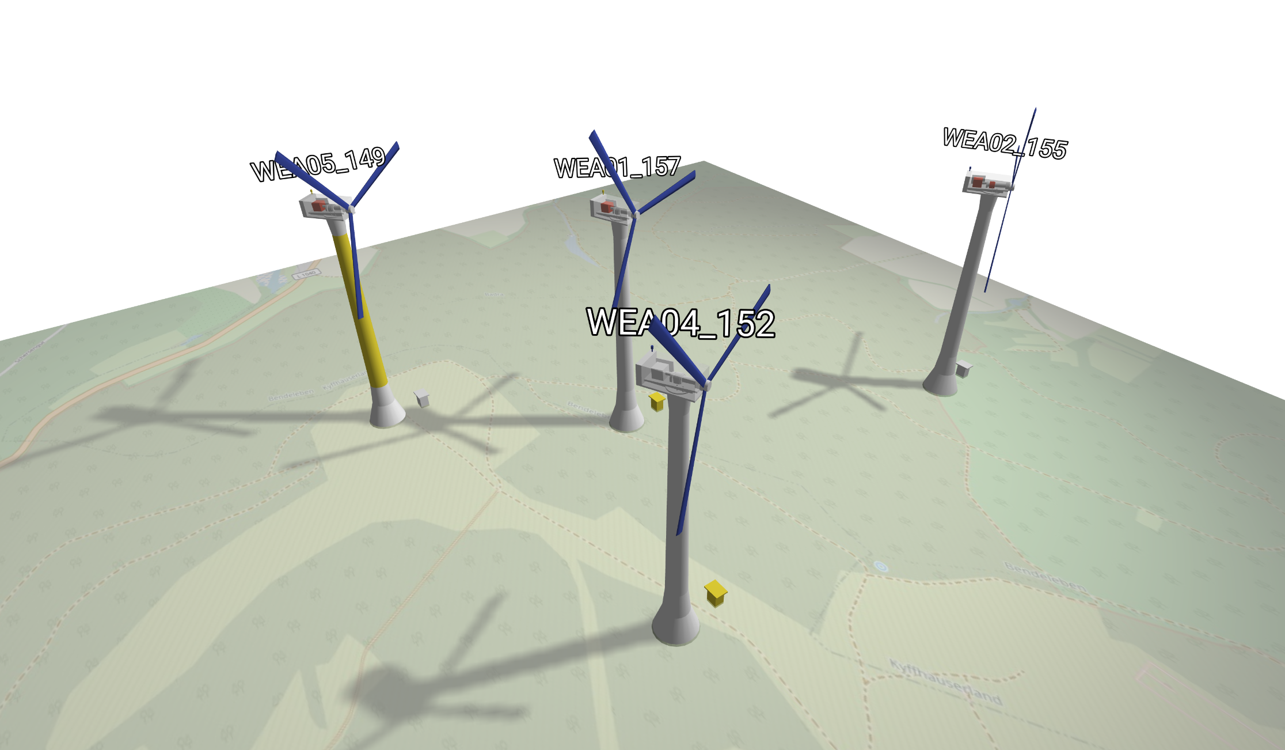
Who We Are:
at a Glance
Turning Data into Interactive Digital Twins
2

Slide 3
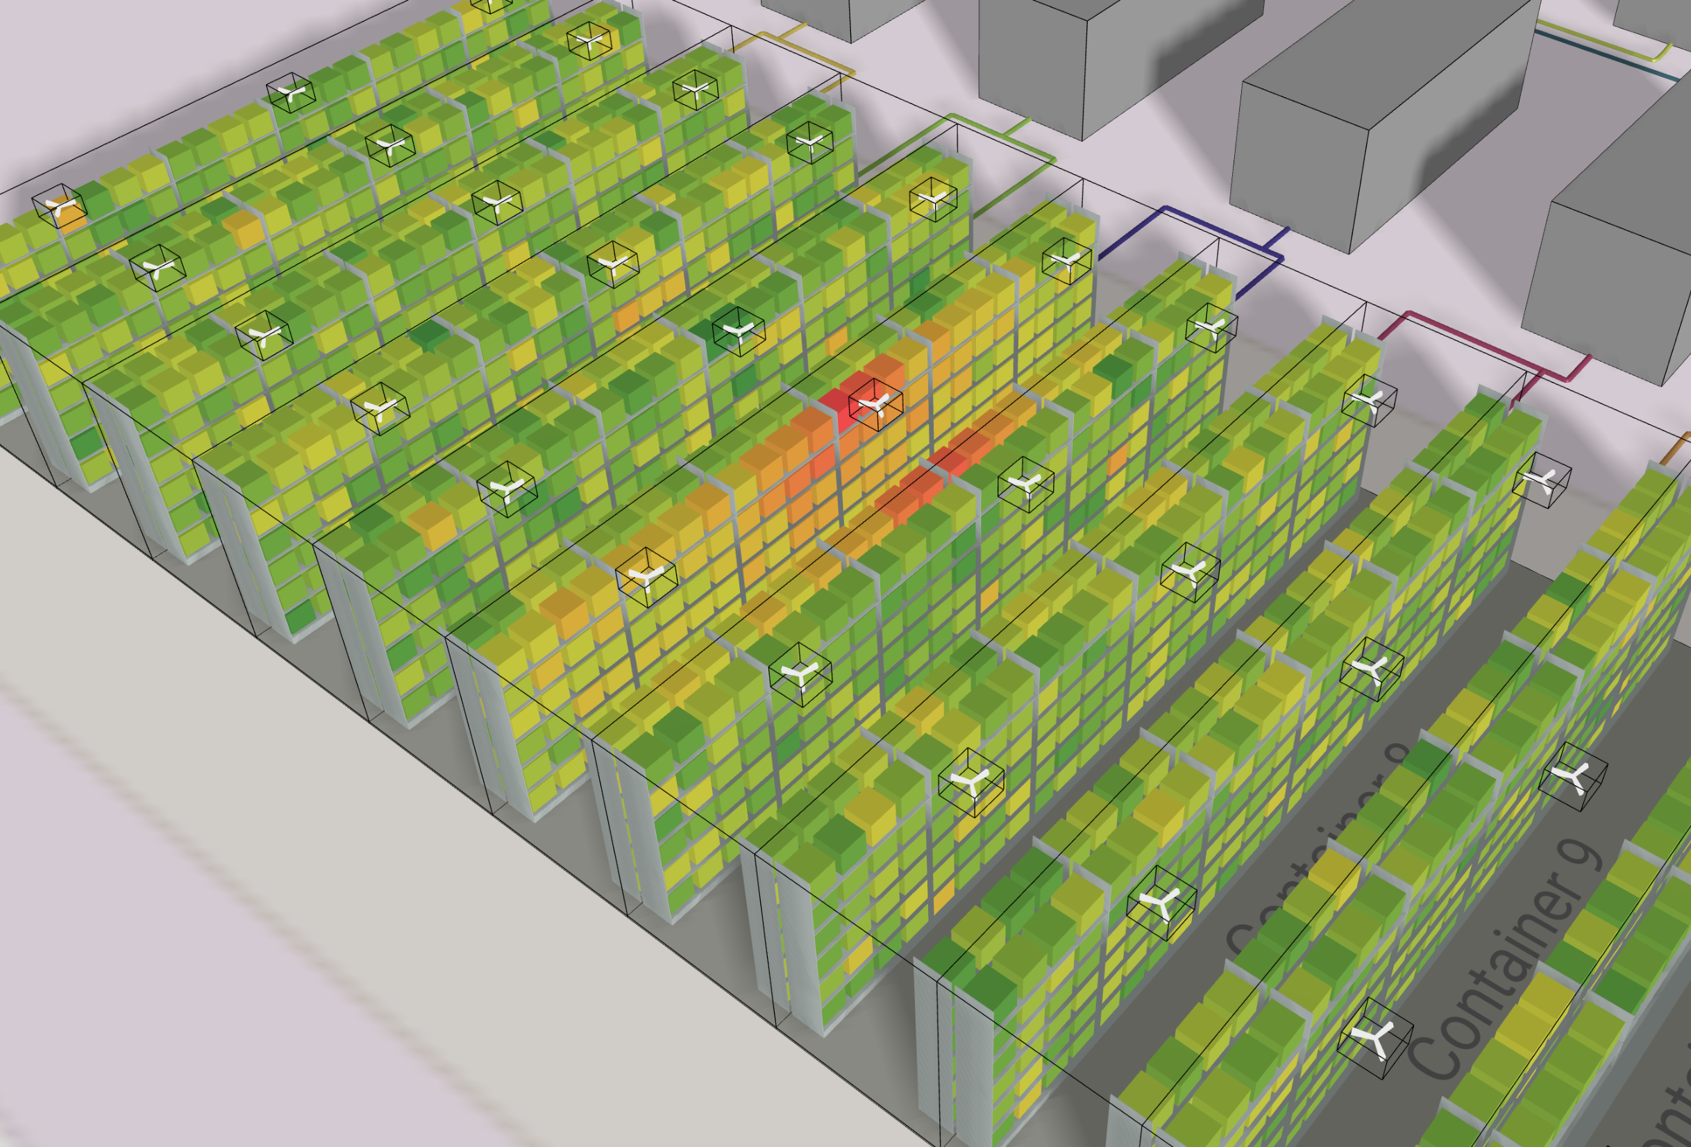
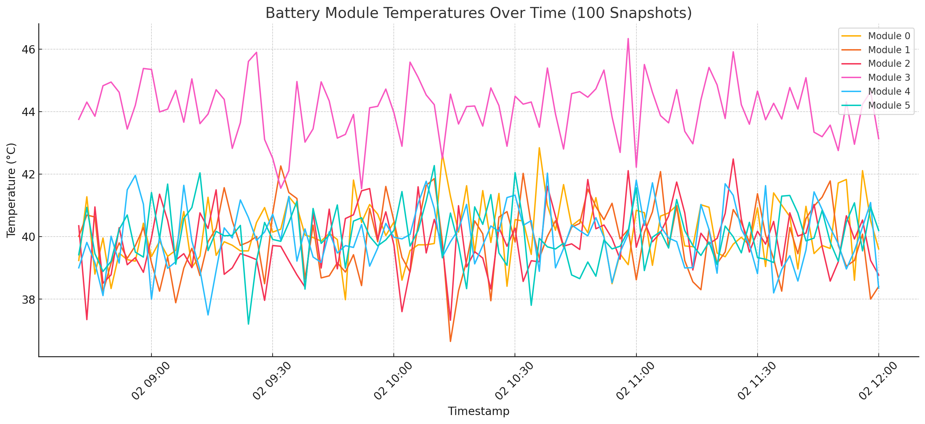
We live in 3D.
Why analyze in 2D?

Slide 4
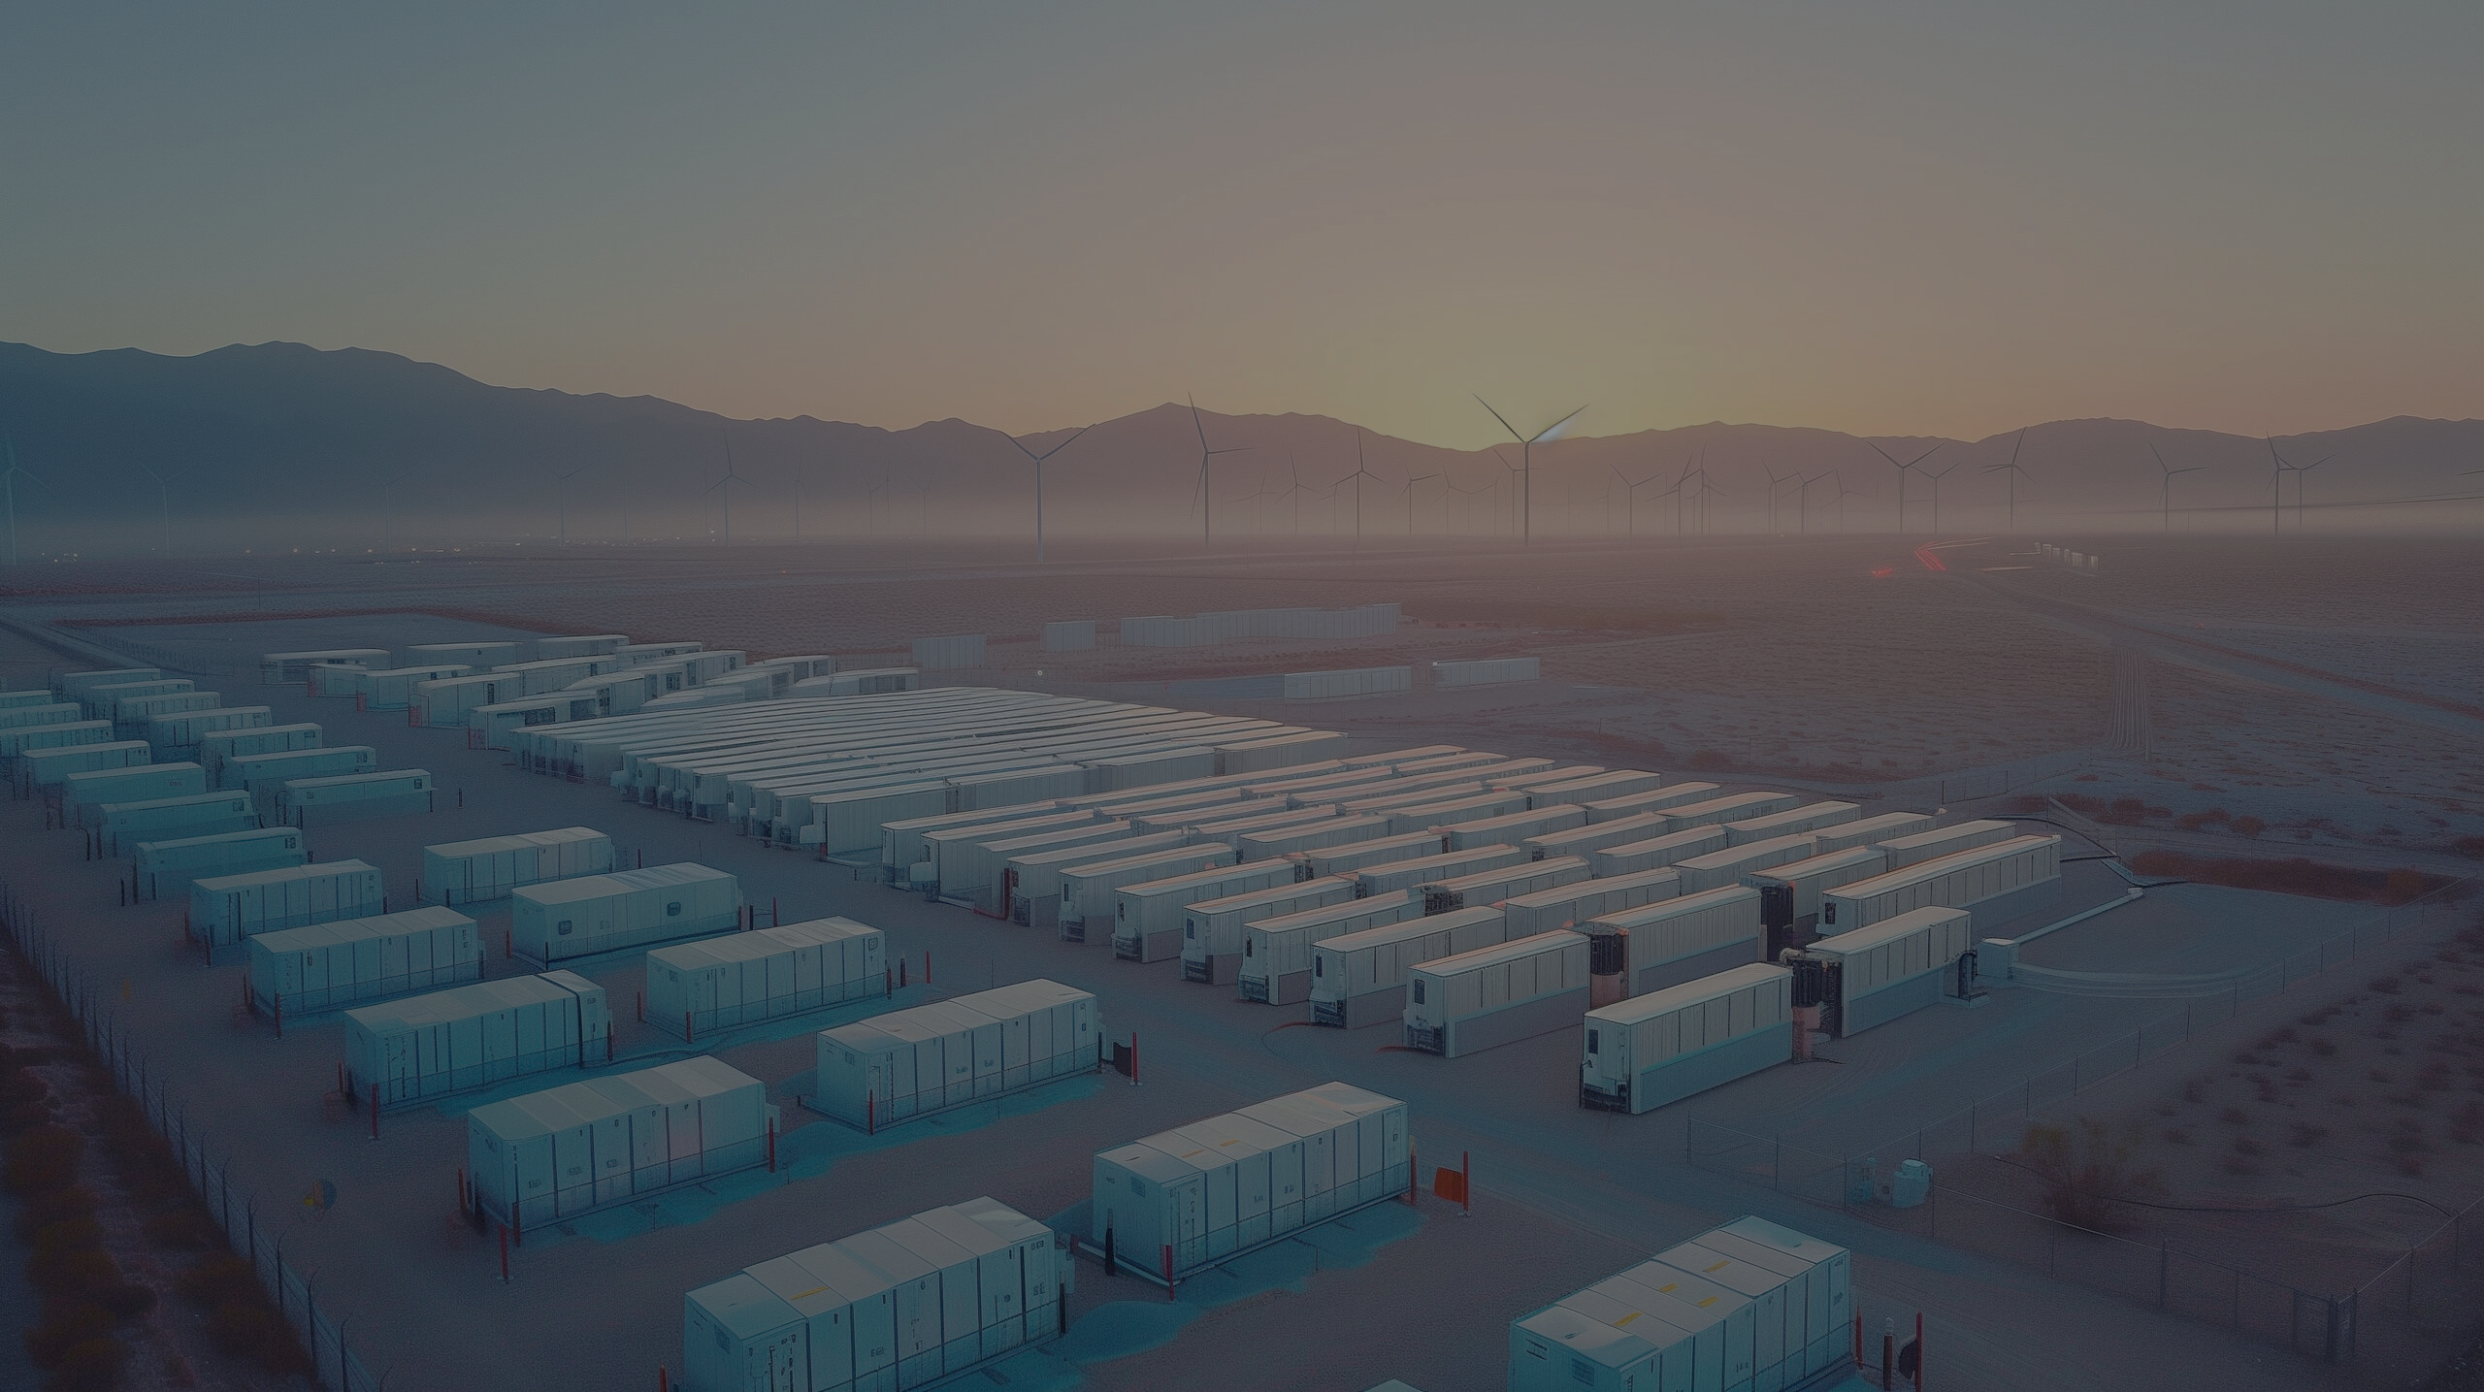
Case Study
Smarter Battery Management through 3D Interaction

Slide 5

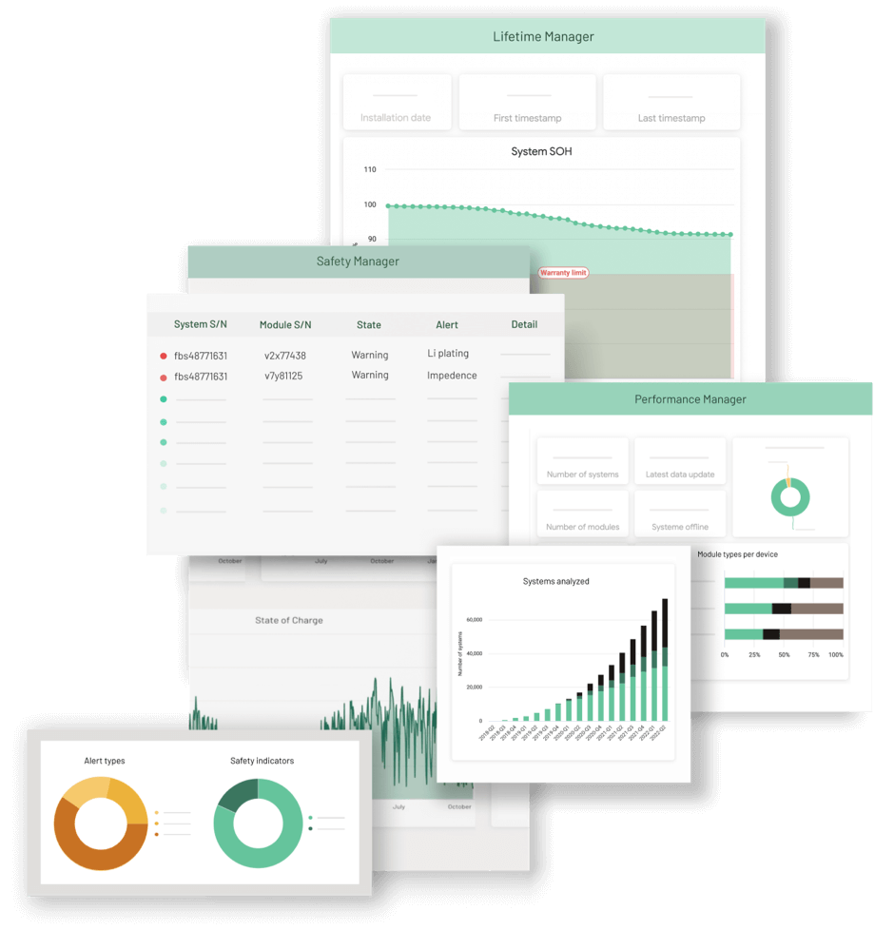
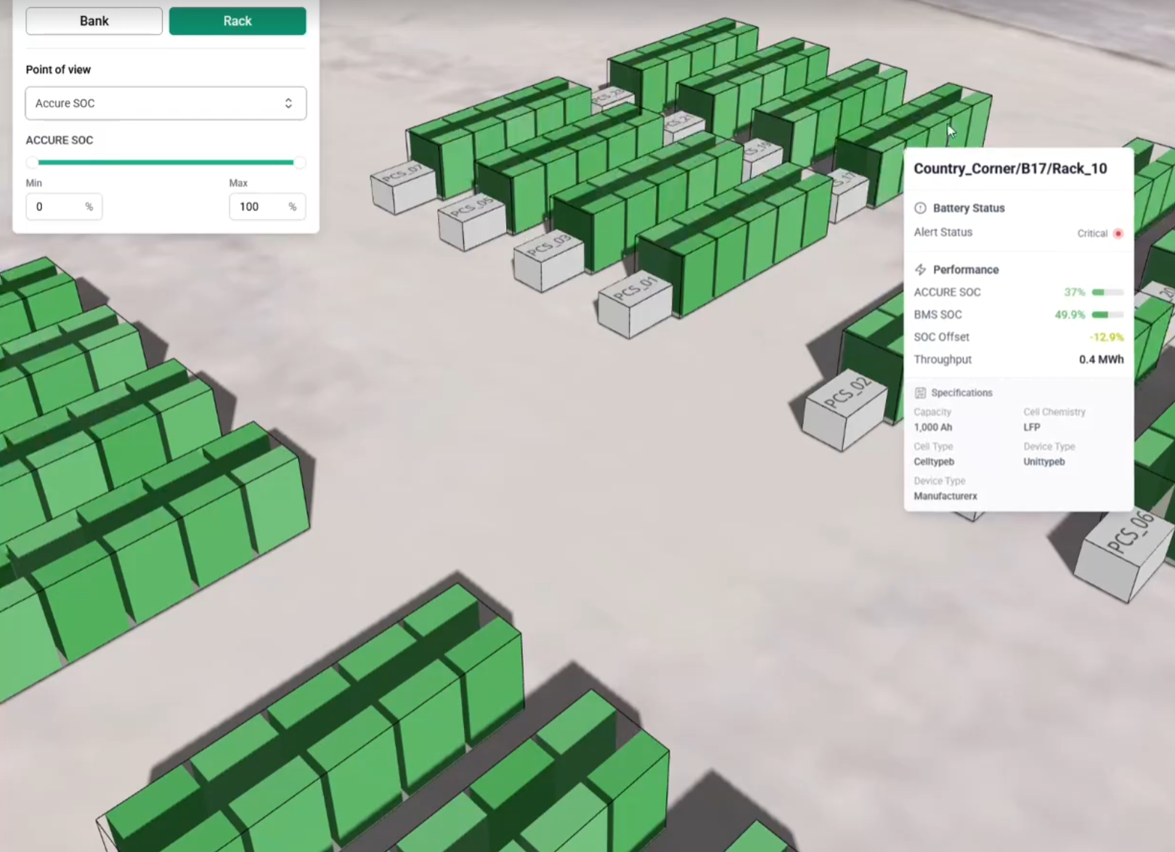



Collaboration with
Battery Insights – Made Spatial
State-of-the-art predictive algorithms
Web-based analytics platform
Interactive 3D digital twin

Slide 6
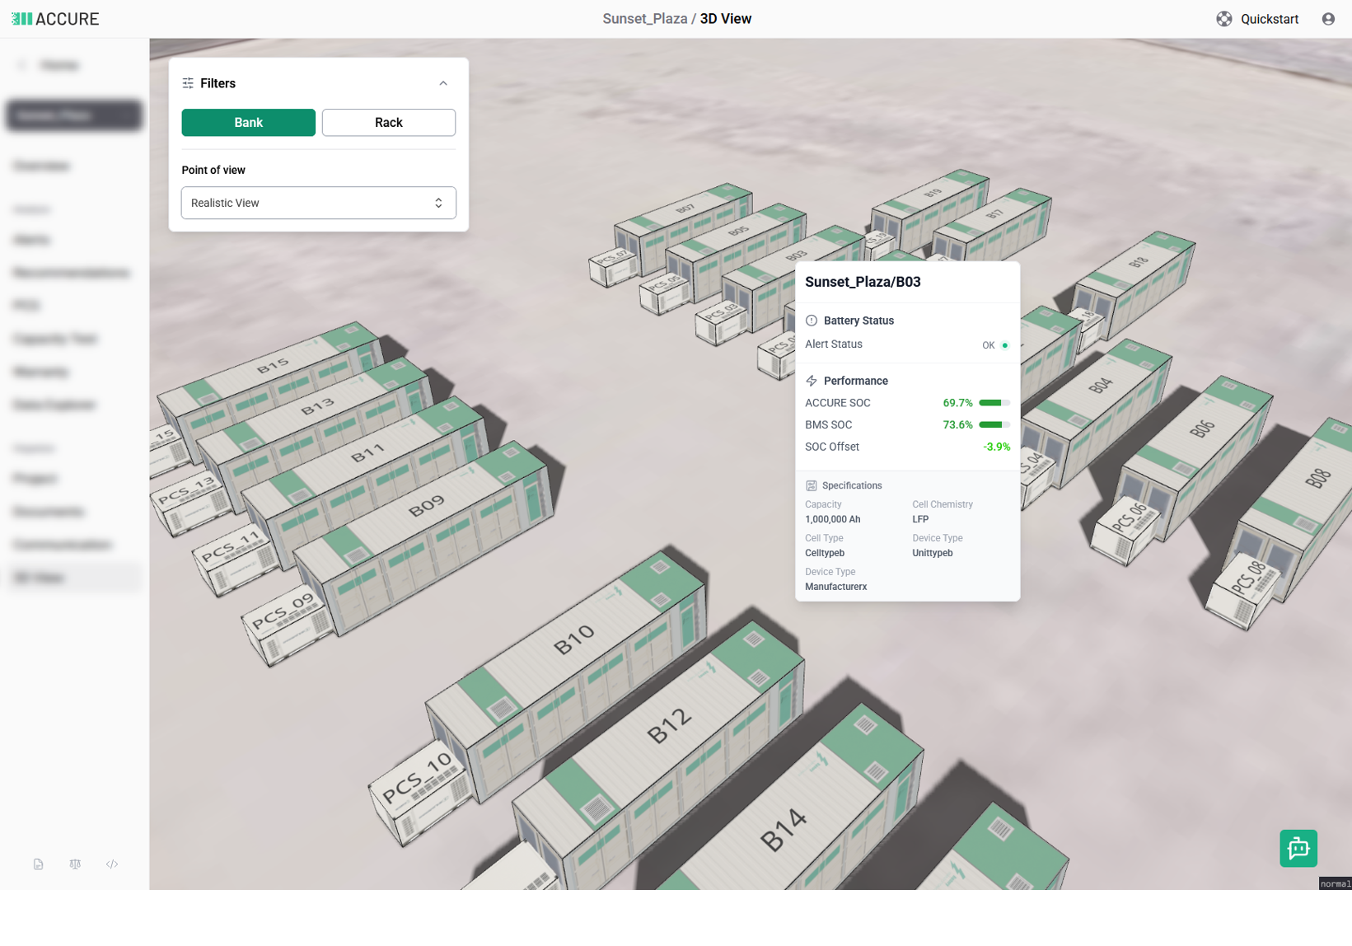
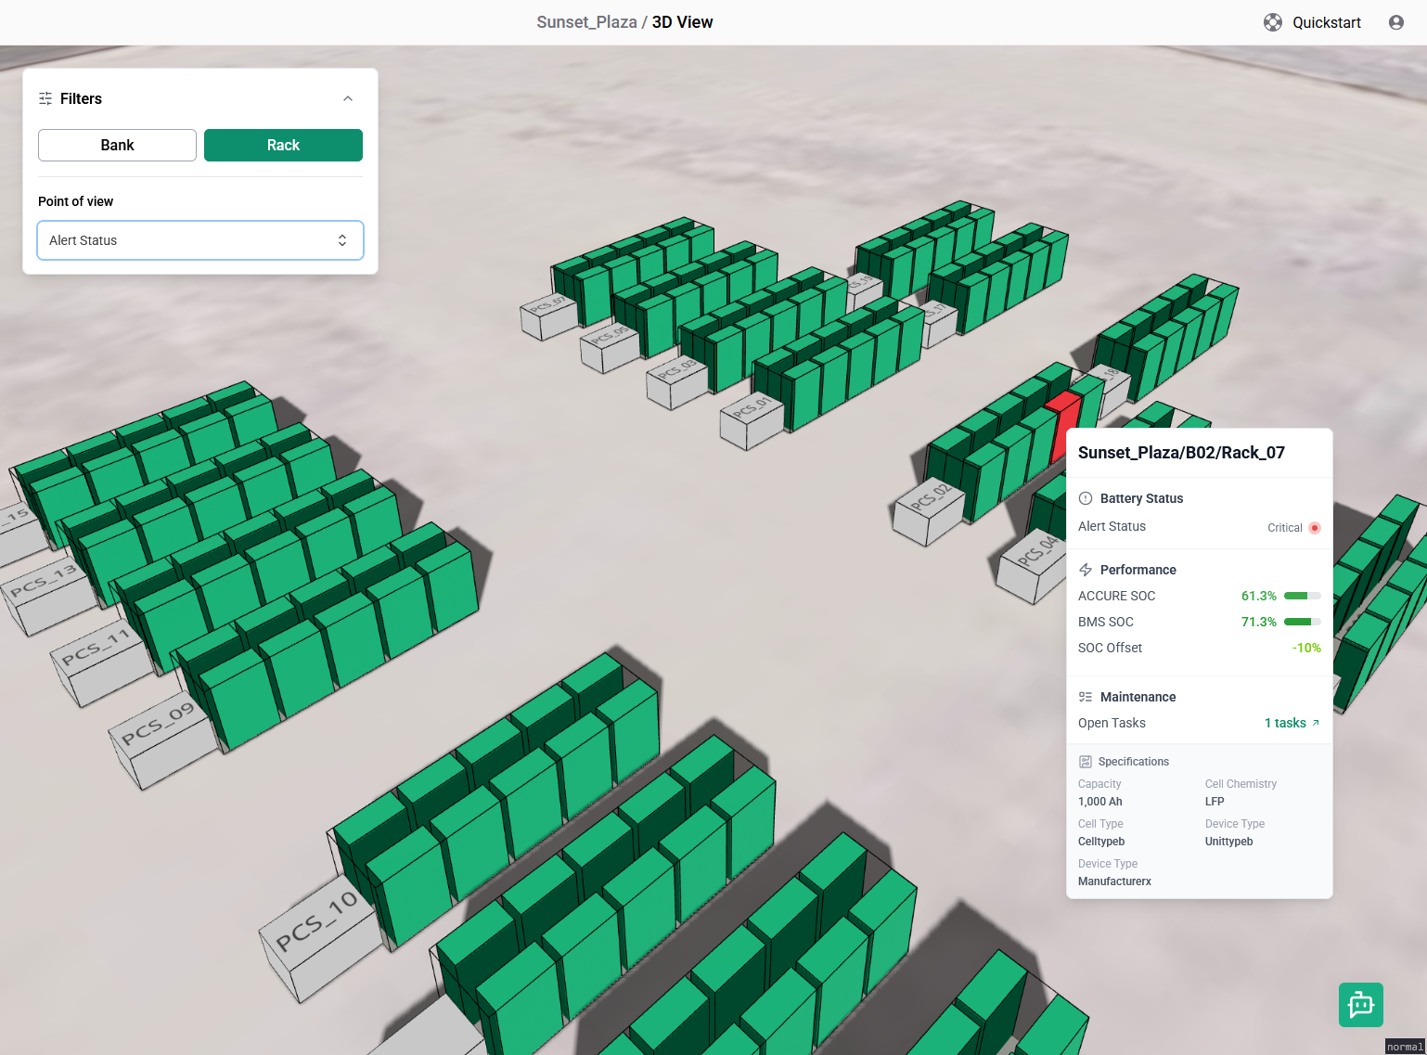
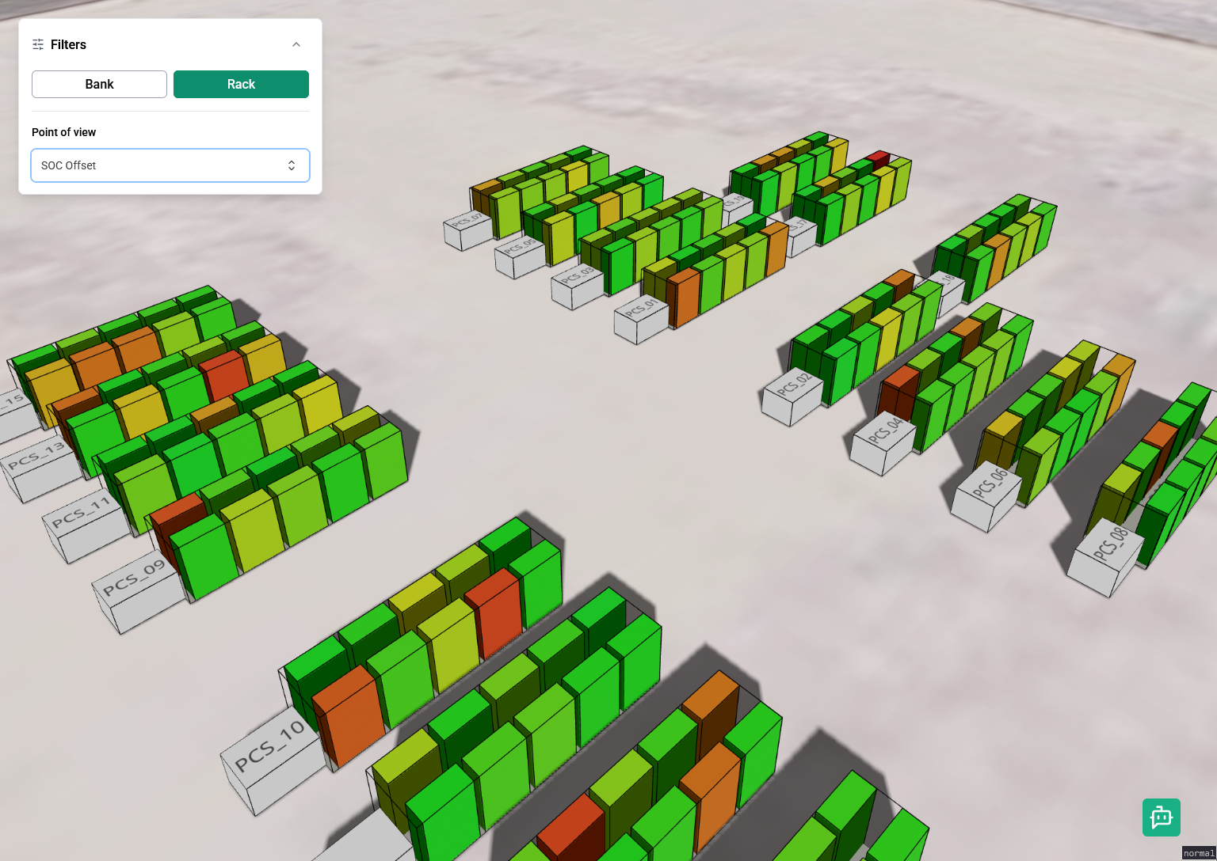

Slide 7

Looking for valuable information in your data?
Visit us at C5.580E
Curious for more?
Discover else42 at www.else42.de and dive into the future of 3D data visualization and immersive analytics!

